Slide 1
Neuroglancer Link Resurrection
How to Bring Neurolancer Links Back From the Land of the Dead
A Tutorial on How to Retrieve a Dead Link, Lost Link, or a Link That is too Long to Paste

Slide 2
Enter You:
“Oh gosh, my Neuroglancer link hath disappeared. Hark, what dreadful circumstance! What shall I doest to upend my sorrowful unfortunance?”
Tutorial begins on slide 4, Enjoy.

Slide 3
Enter: https://meyerweb.com/eric/tools/dencoder/
“By the gods! This web page brings hope to the darkest hollows of plight. Could it be? Revival of my lost link!?”

Slide 4
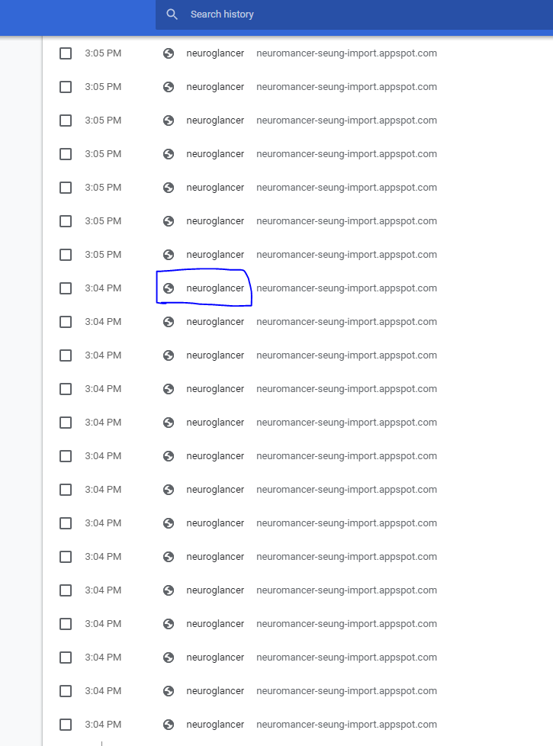
Enter Chrome History:
Navigate to your browser history.
For the sake of this example we used
Chrome

Slide 5
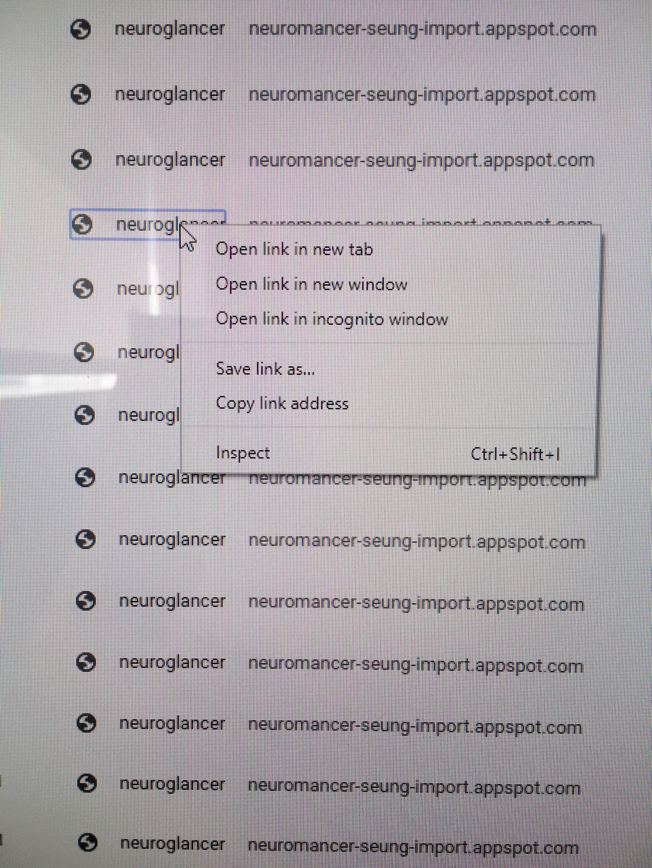
Right Click The Dead Link
------------------------------------------------------->

Slide 6
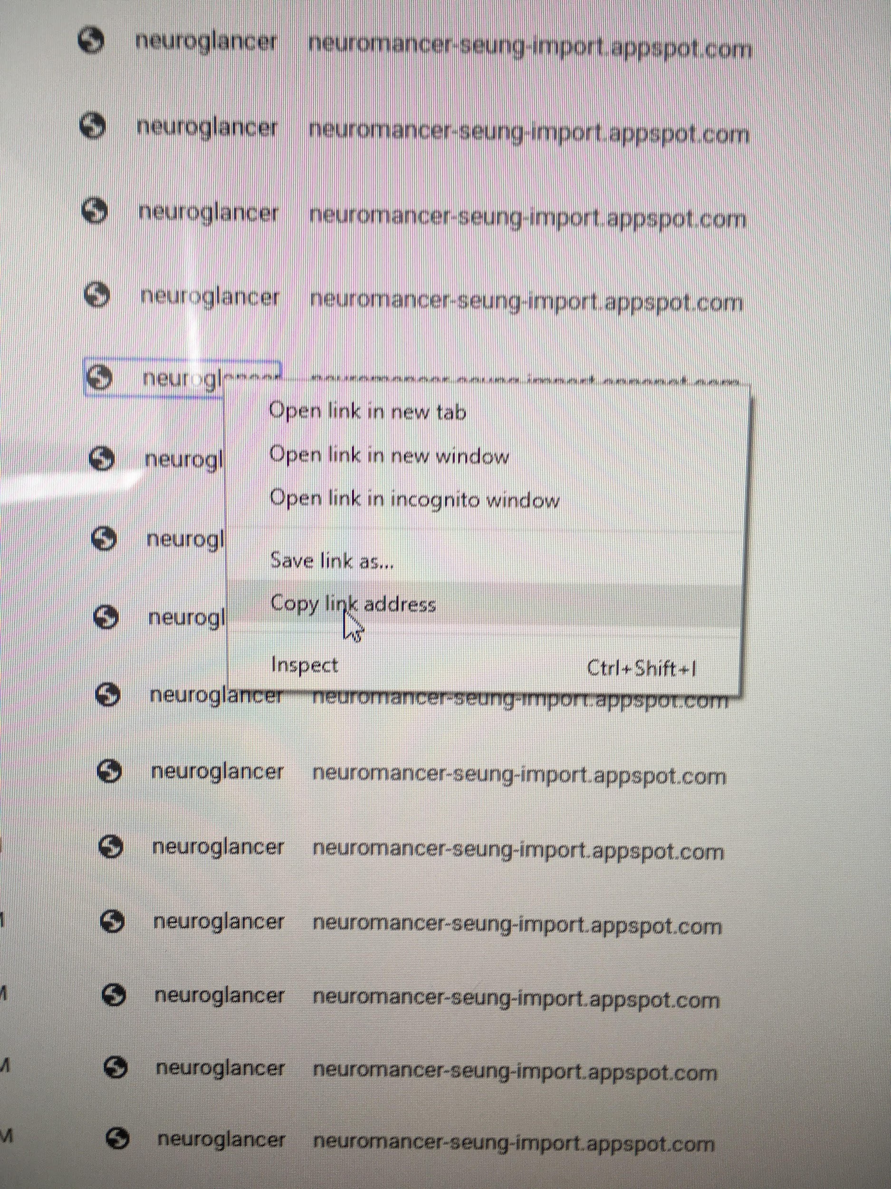
Copy HyperLink
---------------------------------------------------->

Slide 7
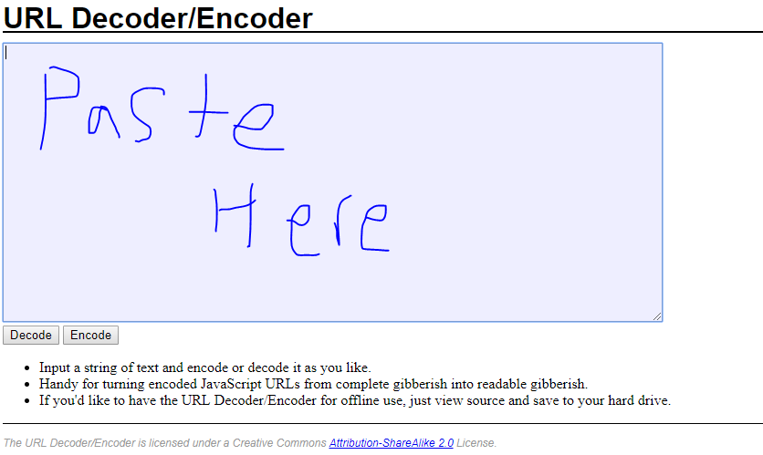
Navigate to: https://meyerweb.com/eric/tools/dencoder/
Paste your link in the decoder
Where it says: Paste Here--->

Slide 8
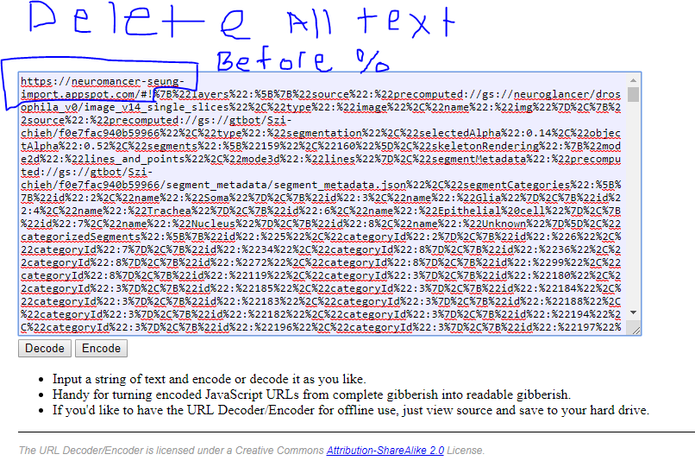
Delete The Hyperlink
Delete all the hyperlink stuff
So all the “http:whatever!”
Everything up until % after the !

Slide 9
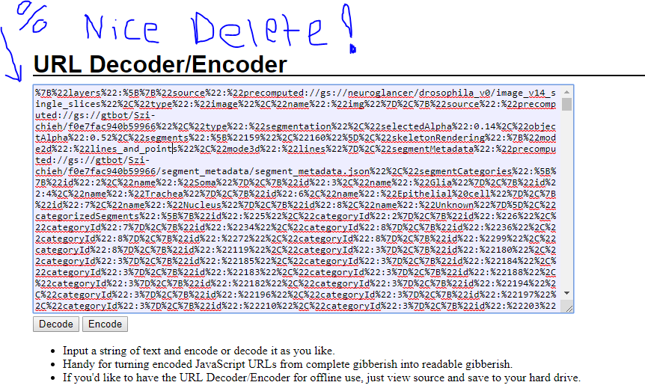
A well deleted Example
What it looks like
------------------->

Slide 10
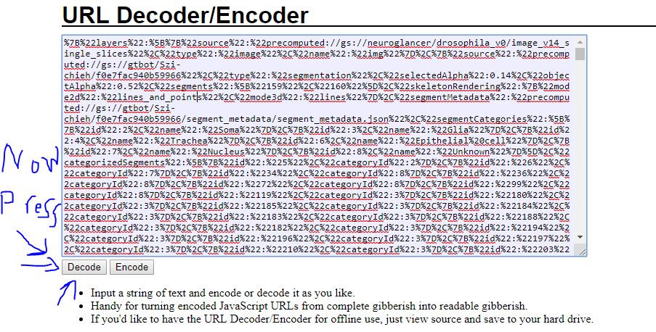
Time to Resurrect aka Decode
Press “Decode”
---------------------->

Slide 11
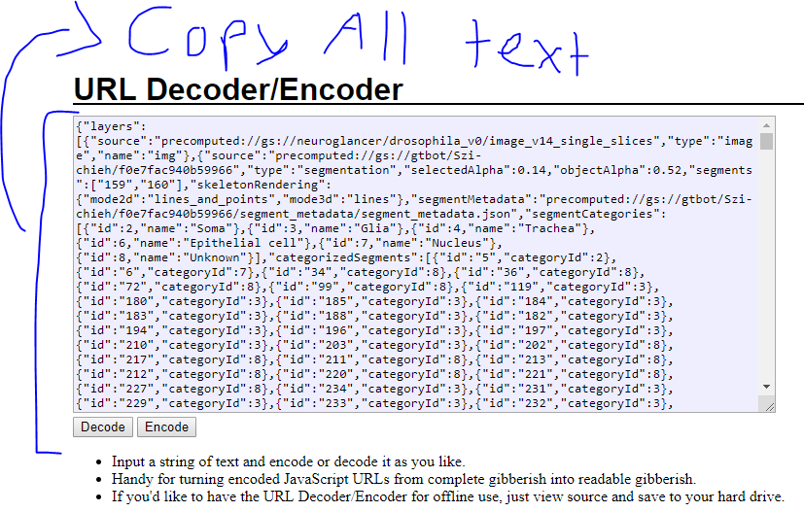
Post Decode
After decoding instantly
The text changes
Copy all this text ------>
Ctrl + A is helpful

Slide 12
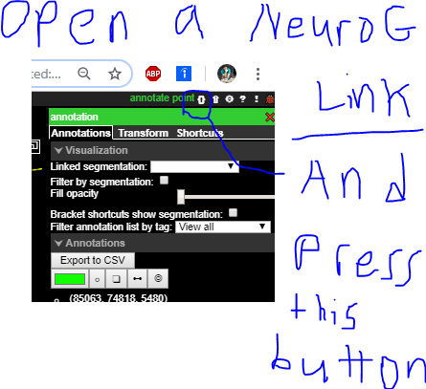
Open a Dummy Neuroglancer Link
Once link is open find the brackets button
It’s in the top right

Slide 13
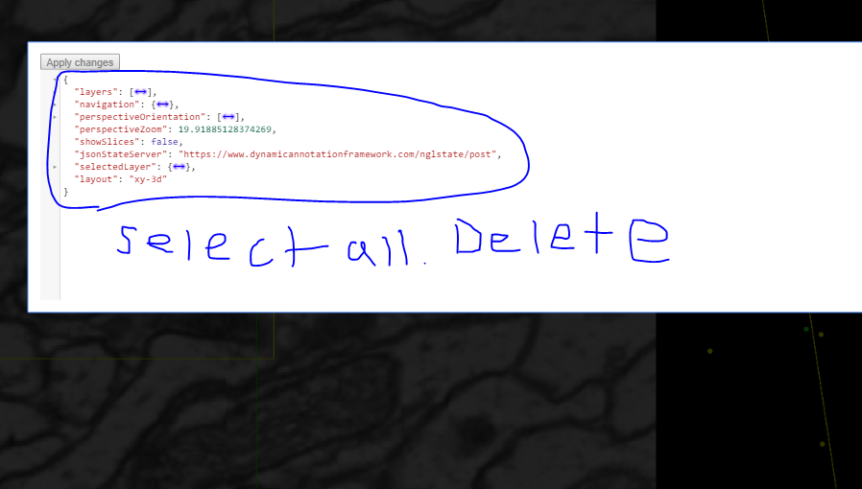
After Bracket Button
In this new window
Select the guts
And remove them
------------------------>
Ctrl + A helps

Slide 14
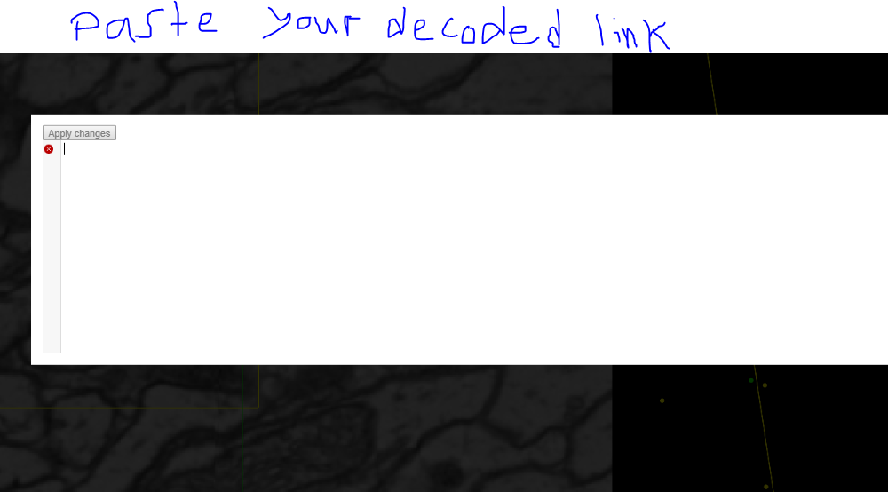
Paste Your New Soul Here
Paste Decoded
Link
--------->

Slide 15
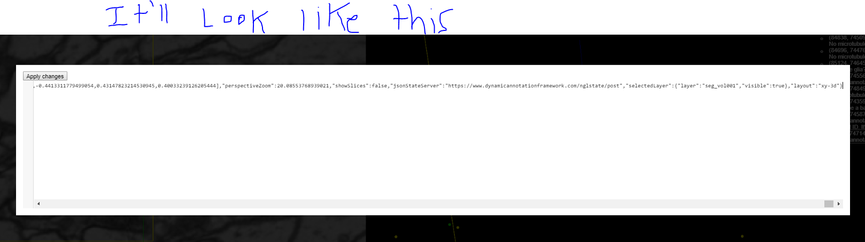
Should Look Like This

Slide 16
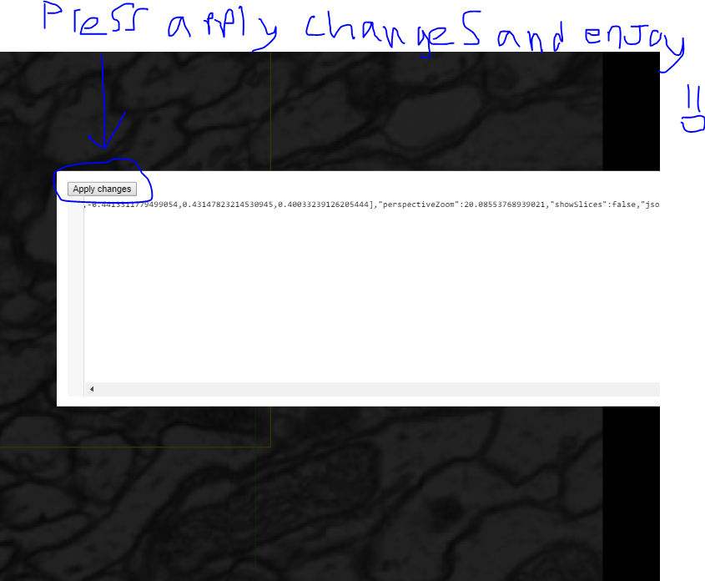
Press Apply Changes
Once you hit apply changes
Your Neuroglancer Link will be
REBORN!!!!!
Thanks to Manuel for teaching me this necromancy.
Credit where credit is due!
Disclaimer: With Great power comes great responsibility. Use power wisely and never under the influence.

